Slide 1
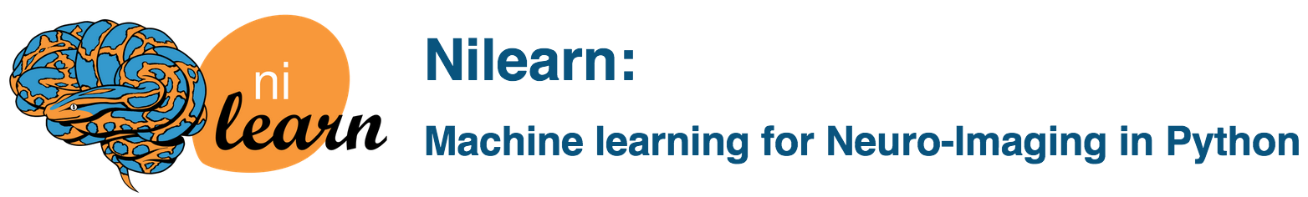
Hands-on-Workshop
Liège
25 + 26. Januar 2017

Slide 2


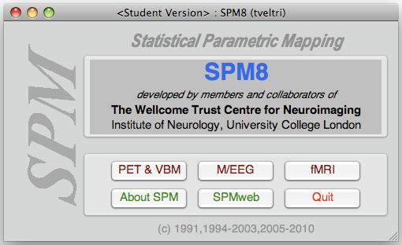
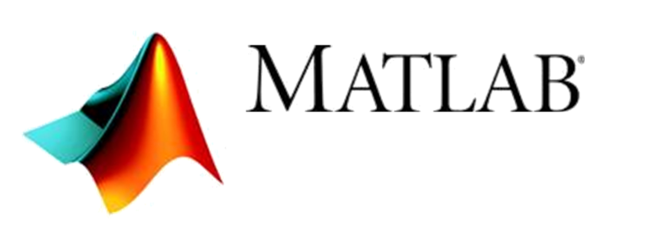
Notes:
We probably all know our friend SPM
Mostly likely due to SPM, we have a rich legacy of Matlab code in the neuroimaging field…
pioneering software package
HISTORY
The idea of making voxel-specific statistical inferences, through the use of statistical parametric maps, emerged from the then young brain mapping community in response to the clear need to make valid inferences about brain responses without knowing where those responses would be expressed.
to develop a valid and rigorous framework for making inferences about activation studies
repopularized Gaussian Field Theory as a means for multiple comparisons correction,
The advent of fMRI brought with it a new wave of innovation and enthusiasm which carried imaging science, along with genomics and molecular biology to the forefront of scientific endeavor at the end of the last millennium.

Slide 3
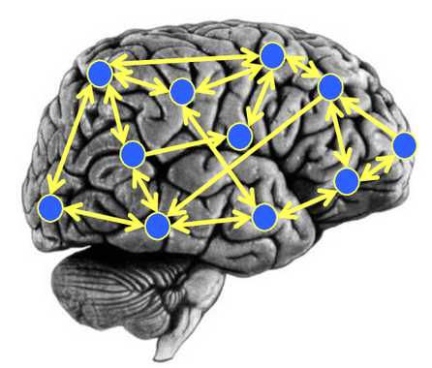
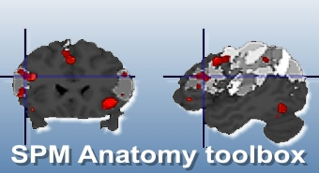
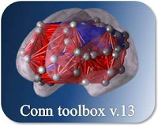
DCM
Anatomy Toolbox
CONN
Notes:
Popularity of the SPM as a quasi standard in the field encourage software packages to also be in
DCM: Bayesian models for effective connectivity estimation
Anatomy:
CONN:
One ask at that point: Why then lunch a new neuroimaging software package in Python?

Slide 4
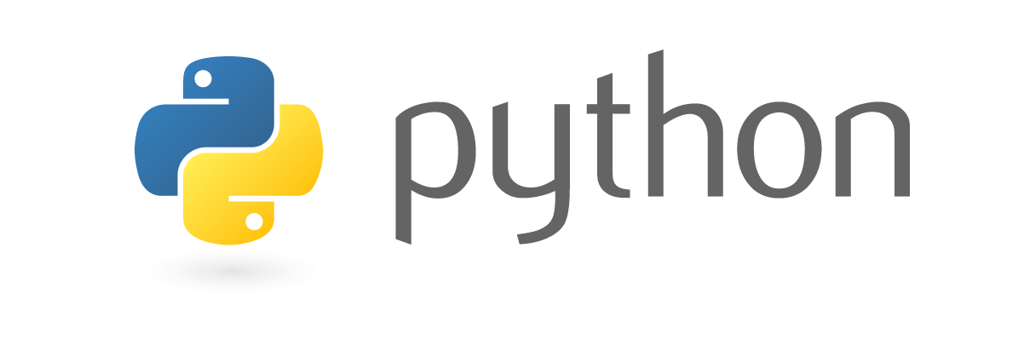
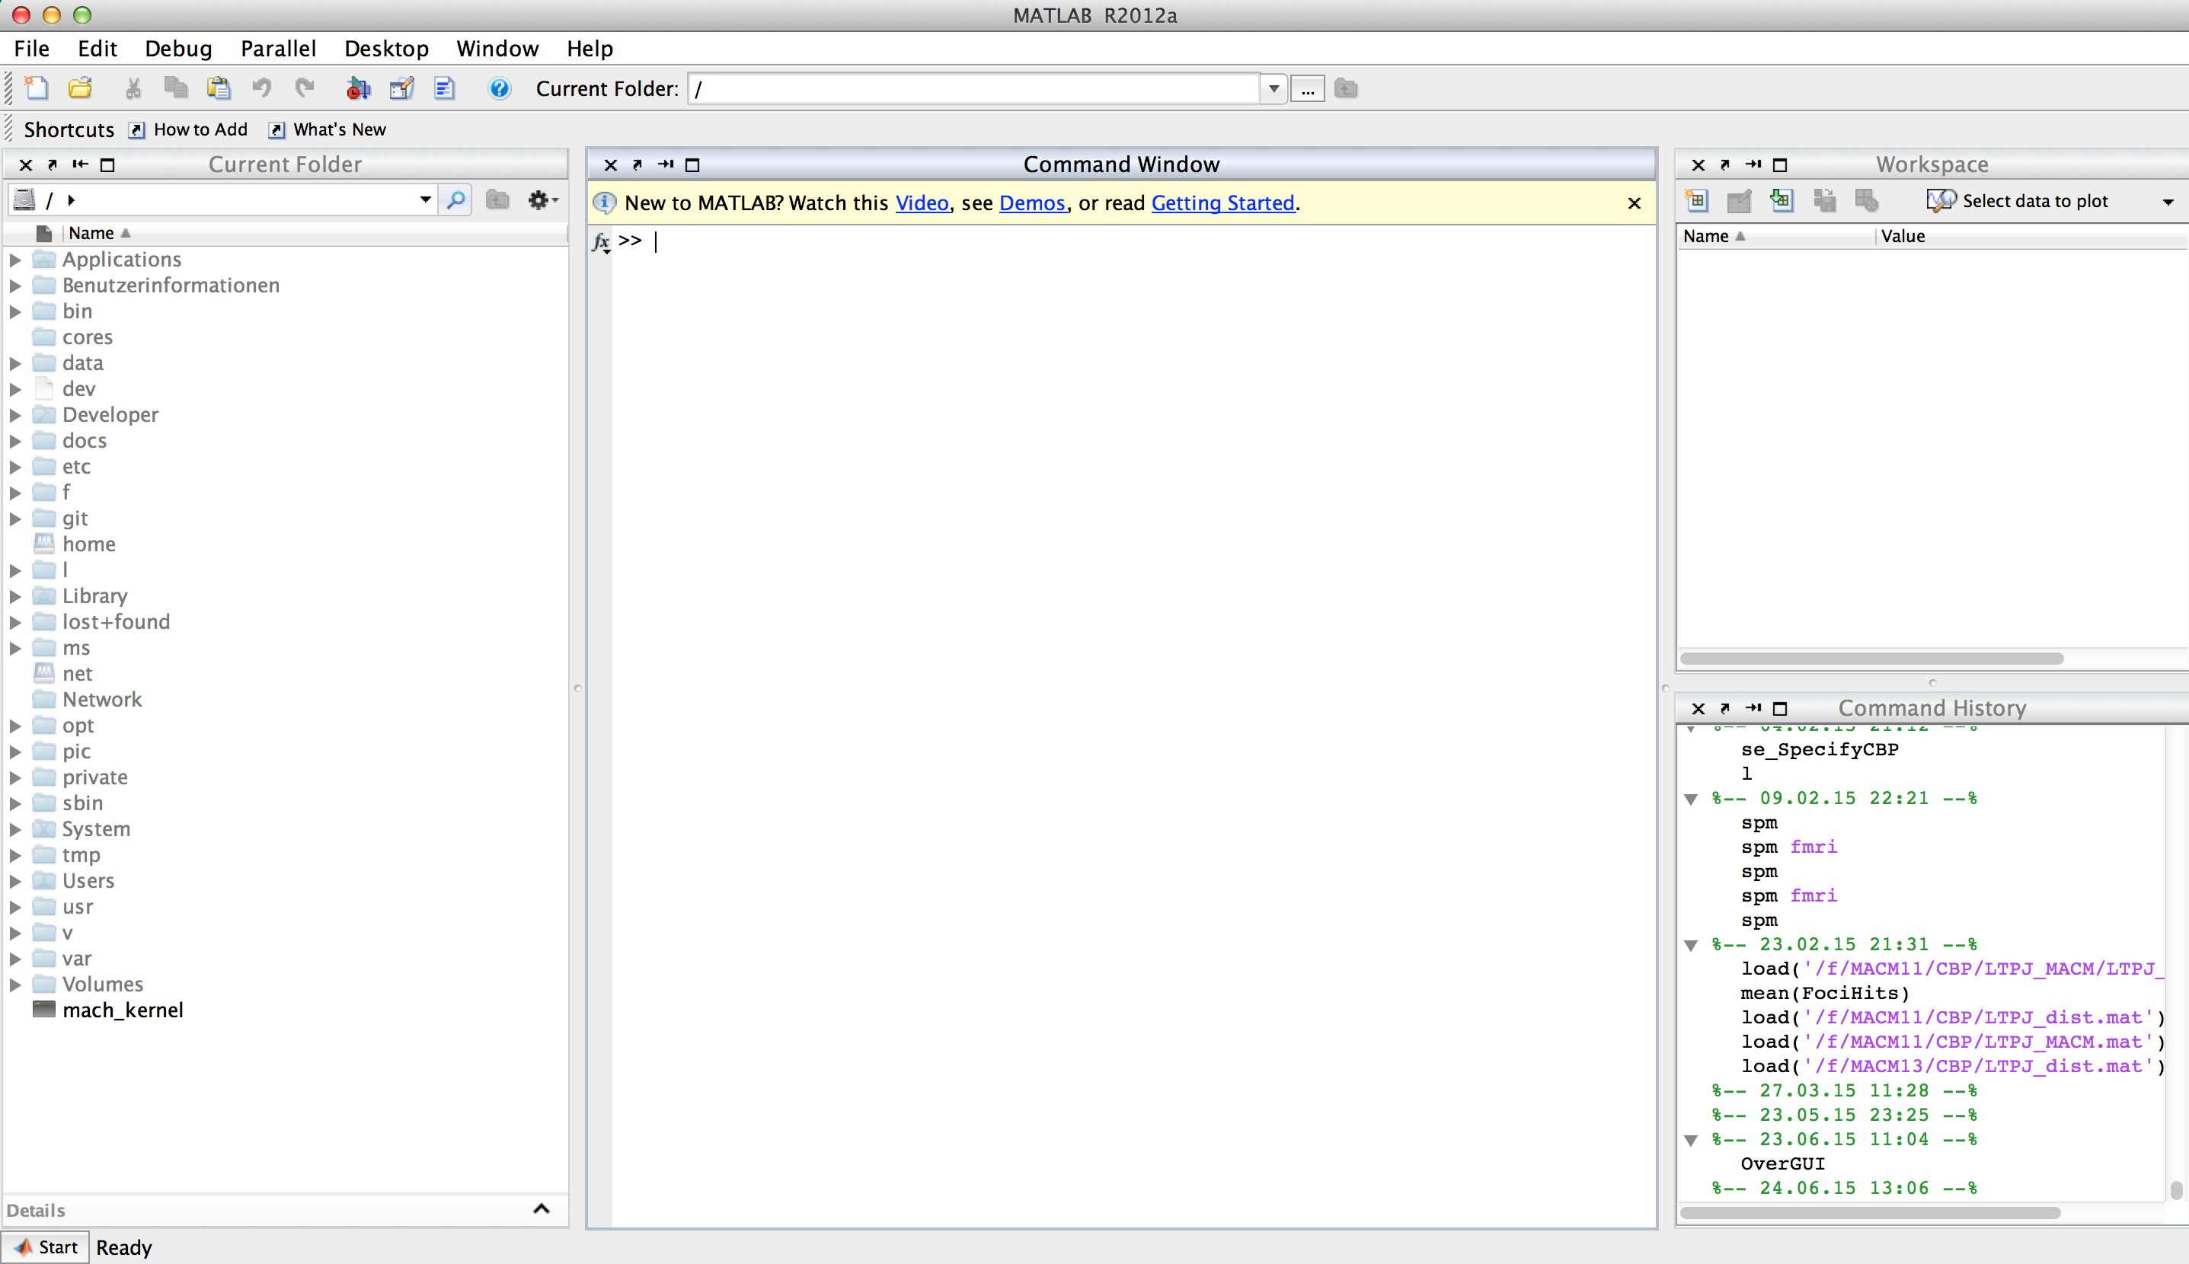
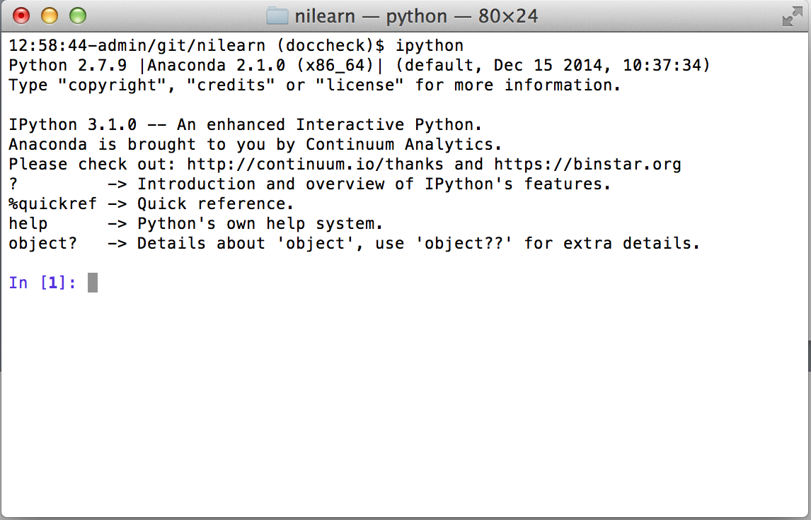
What is the programming interface?

Slide 5
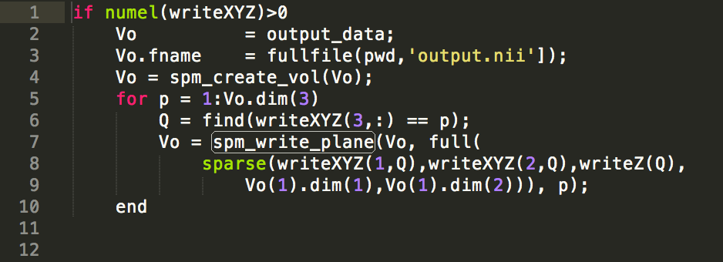
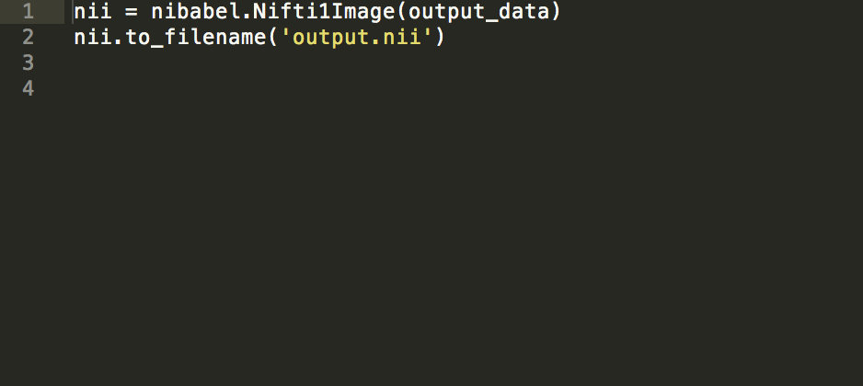
Save image data to nifti file?
Notes:
Python code tends to be more compact and more readable than Matlab code
Unlike Matlab, which uses end statements as closures (i.e., to indicate the end of a block), Python determines the scope of a block based on its indentation
Matlab uses parentheses for for indexing and parentheses for function calls
In general, Python code is almost always smaller (in terms of lines of code, assuming only one statement and no more than 80 characters per line) than Matlab code
For programs that perform extensive string processing (e.g. output files from stimulus presentation software), the advantage of Python is even greater.
Python's support for automatic broadcasting allows for cleaner, more readable code.
Better readability leads to fewer bugs, faster debugging when bugs are introduced, and faster comprehension when one must work with someone else's code.
Python offers excellent support for dictionaries (hashes) -> Python data structures are superior to Matlab data structures
Object-oriented programming (OOP) in Python is simple and elegant, Matlab's object-oriented programming scheme is complex and confusing.
Python code is 10x faster to write than C or Fortran.
expressiveness
Python is a real programming language
readability was a primary consideration when Python’s syntax was designed
Matlab is not, it is a linear algebra package.
Python is considered a winner in coding time: „fast prototyping“

Slide 6
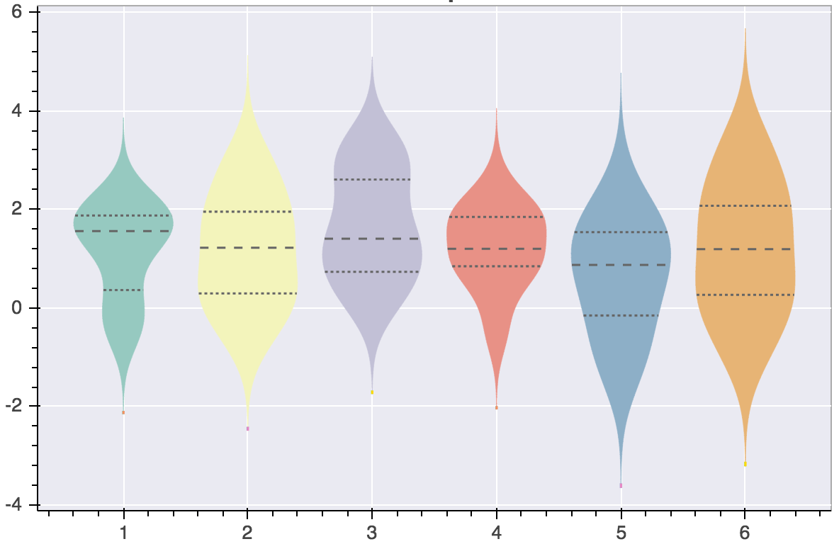
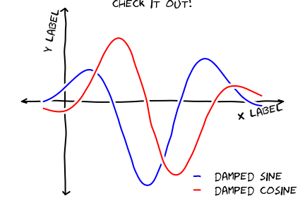
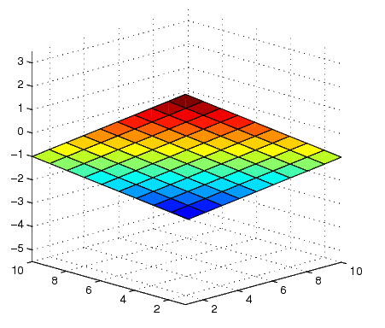
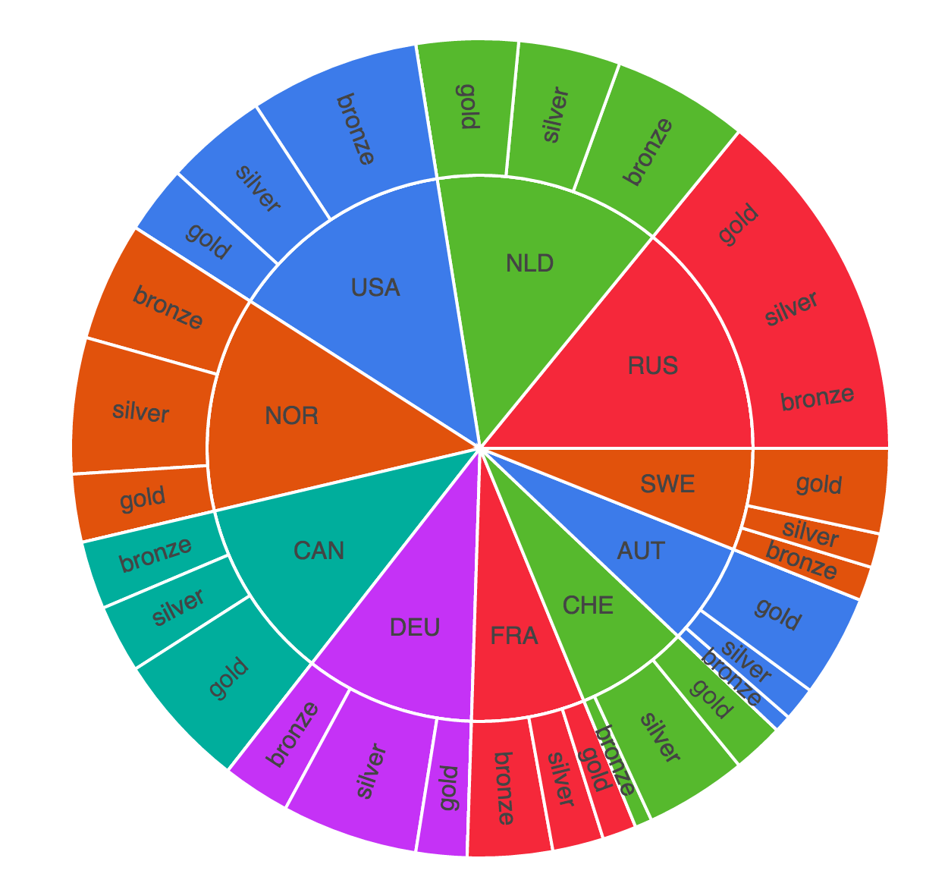
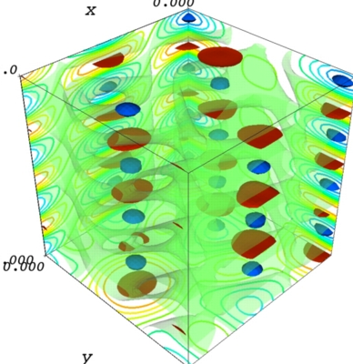
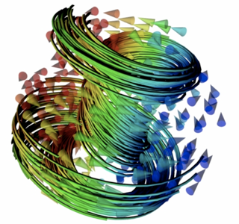
How about graphics libraries?
Notes:
Matlab
essentially one main graphical plotting API
Python
explosion of graphics libraries that are always better in quality
everything from fun plots to high-end technical 3D engineering plots

Slide 7
Costs for cluster computing?
> 1000 $
0 $
per user
infinite users
Notes:
High-performance computing on a distributed computing platform
Computationally intense programs
This is becoming a problem as we scale to always bigger datasets
M
„your institution has most likely not paid to run parallel Matlab code at large scale“; yet migration to a different parallalization solution is costly
high-level parallel constructs and tools (uses MPICH2 to implement the parallelism in the parallel toolbox)
MDCS is also difficult to maintain from the HPC staff’s perspective
The drawback of the Parallel Computing Toolbox is that it contains digital restrictions that only permit it to operate with 12 cores or fewer on a single computer. -> not due to technical limitations (since based on open-source software) but a business decision to charge fees
per-worker licensing fees
„Matlab distributed computing server“ regulates access to Parallel Computing; it’s essentially a digital restrictions management (DRM) software
Toolbox software for Matlab; previously sufficient single-machine license needs to be extended for scaling to parallel processing
Limited number of work threads, limited number of users per licence, each toolbox costs extra money
restrictive licensing policies
unanticipated expenses late in the software development cycle
a good product if you don’t mind the price tag
charges additional fees for the removal of arbitrary restrictions on that capacity through MDCS
each Matlab toolbox is licensed individually
-> may ultimately restrict your capacity to do research
designed to extort money from locked-in Matlab users
P
perhaps more appealing
Python is free and open
Open-source parallelism
simply log in to the HPC cluster and submit your jobs
no restrictions regarding user, used cores or other

Slide 8



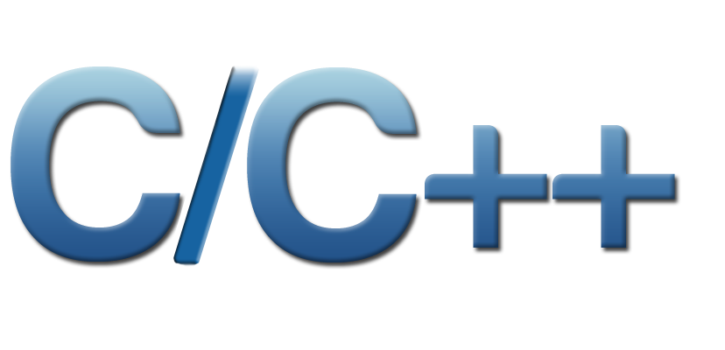
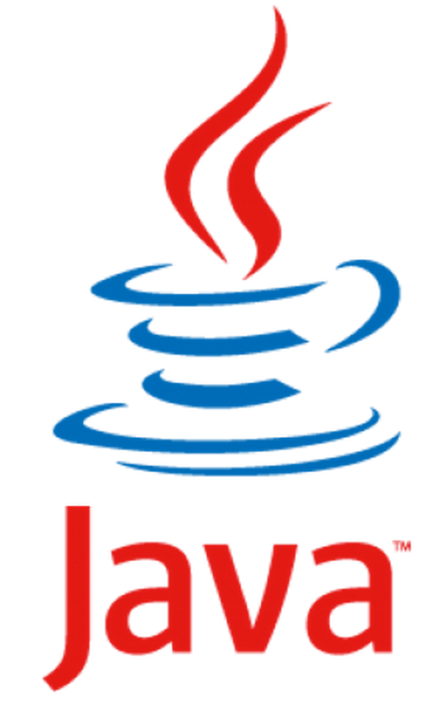

Interoperability with other programming languages?
(and others)
Notes:
Note too that porting code is not the same as writing from scratch. You can often convert code from MATLAB to Python in a small fraction of the time it would take you to start from scratch.
Matlab:
MATLAB’s language design is focused on matrix and linear algebra operations; for turning such equations into one-liners, it is pretty much unsurpassed. However, move beyond these operations and it often becomes an exercise in frustration.
Python: Python can interfact with any language which can be interacted through C, which is most languages
As a side affect of its universality, Python excels at gluing other languages together
on average you would write six lines of C/C++ code for every line of Python.
R: ggplot, datastructures, Need to use that linear regression package in R? RPy puts it at your fingertips.
Matlab: One can call MATLAB functions from Python (through the MATLAB engine) using MLabWrap
Fortran: Have fast FORTRAN code for a particular numerical algorithm? F2py will effortless generate a wrapper.

Slide 9


How are the ecosystems doing?
Notes:
If you have legacy code in MATLAB, then it may make sense to just continue using it.
There is a vigorous, healthy public debate on virtually all aspects of Python, with input from any developer or user who wants to participate. [I have lobbied successfully for minor changes to NumPy, the interactive IPython shell, and the mapping component of matplotlib.] In stark constrast, the Matlab developers at the Mathworks make decisions behind closed doors and tend to be unreceptive or even hostile to suggestions from the outside
M
many established, big, rock-solid packages
P
many mushrooming diverse young packages
bigger support community
exponential
faster access to cutting- and bleeding-edge software technology
This is my main argument: the momentum is in Python’s direction. Even two or three years ago, Python was behind. Now, it’s sailing past Matlab.
Matlab which is playing catch-up with open source software (for example, Matlab is now introducing their own versions of Dataframe, which Python has through Pandas
programmed in a more modern way: it is typical to find automated testing, excellent and complete documentation, a dedicated peer-reviewed publication
documentation comments that are specified by a doc string after the function or method name. These documentation strings add tags to the methods which are accessible by anyone using an interactive Python shell or by automatic documentation generators.

Slide 10

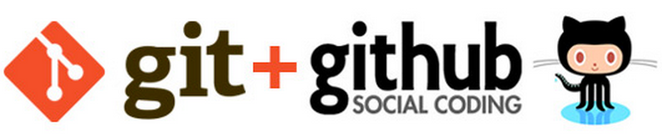
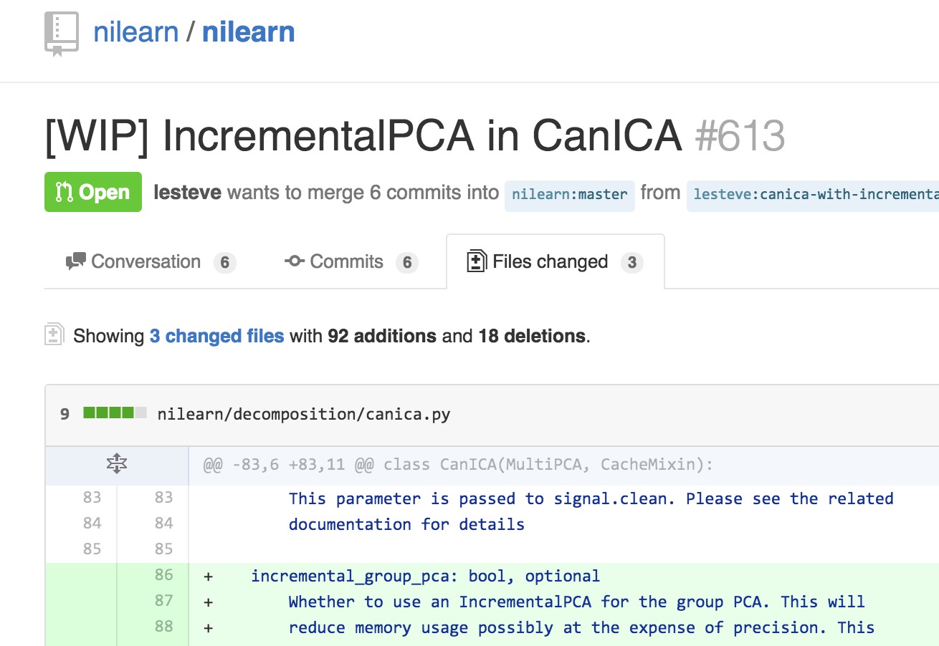
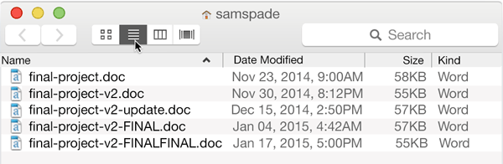
How do people collaborate for software development?
Notes:
M
often no version control
P
type of Facebook for software programmers
improves provenance tracking, reusability and outreach to researchers and interested public
Unlike Git, which is strictly a command-line tool, GitHub provides a web-based graphical interface and desktop as well as mobile integration.
Git does not throw things away. You can always get back where you have been before.
distributed revision control and source code management (SCM) functionality. provides access control and several collaboration features such as wikis, task management, and bug tracking and feature requests for every project. The site provides social networking-like functions such as feeds, followers, wikis

Slide 11

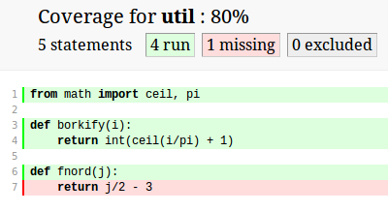
How is the code quality tested?
Notes:
M
P
a culture of robust testing
Unit tests are one of the corner stones of Extreme Programming (XP).
Tests are indispensable for reproducible research
Tests are even more important for non-compiled code
Intuitively, one can view a unit as the smallest testable part of an application.
Unit tests are short code fragments
relies on the repetition of a very short development cycle: first the developer writes an (initially failing) automated test case that defines a desired improvement or new function, then produces the minimum amount of code to pass that test
unit tests
regression tests
=> lingua franca of scientific computing

Slide 12
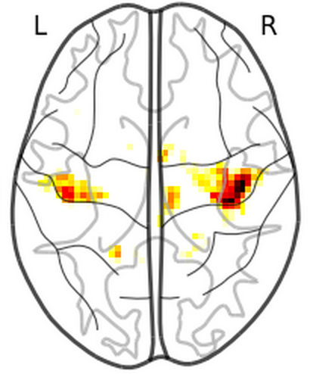

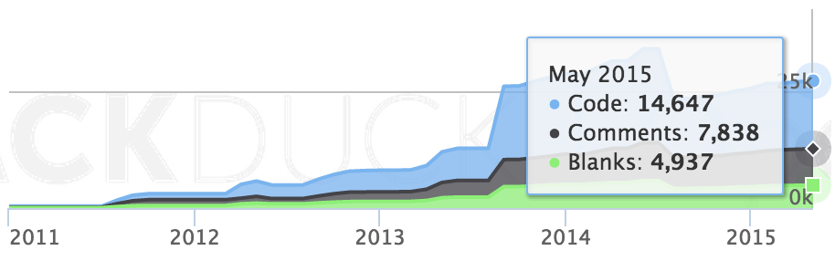
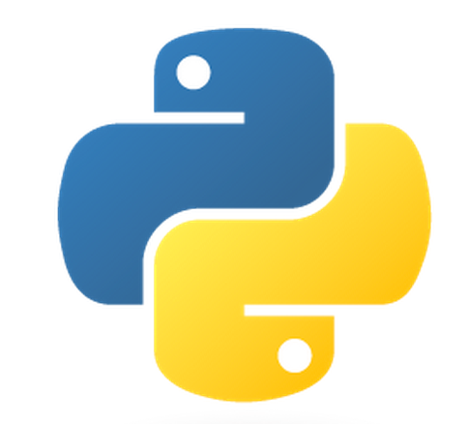
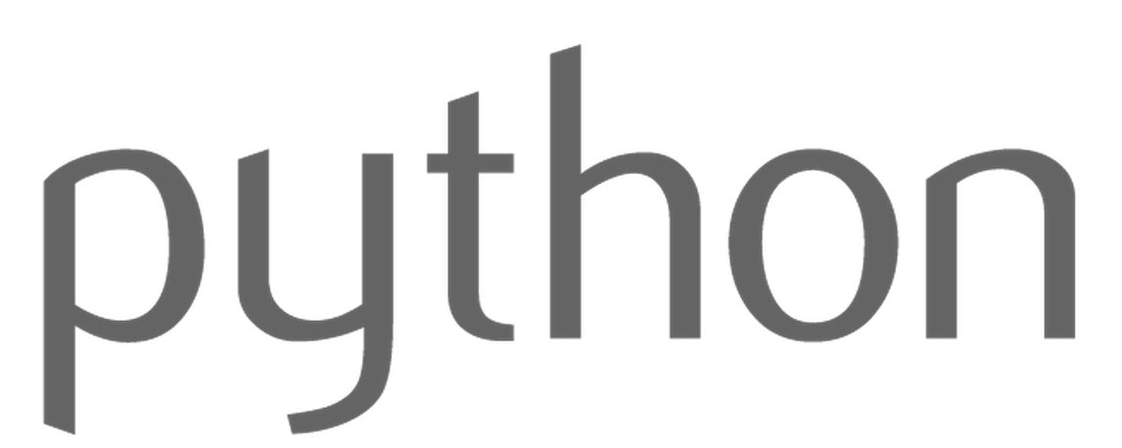
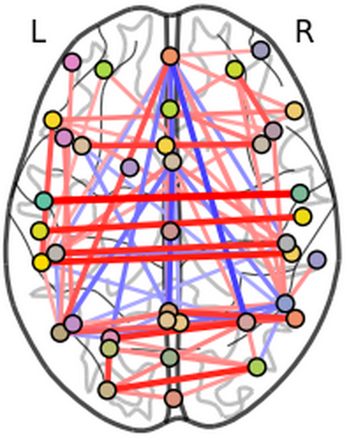


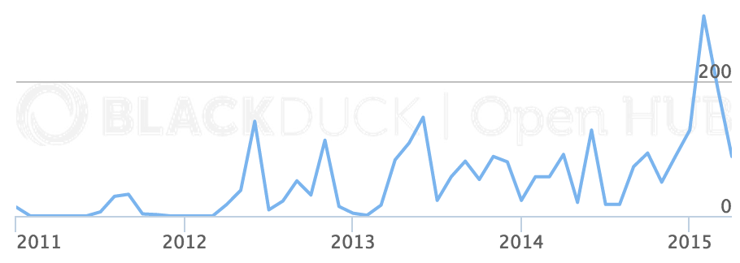

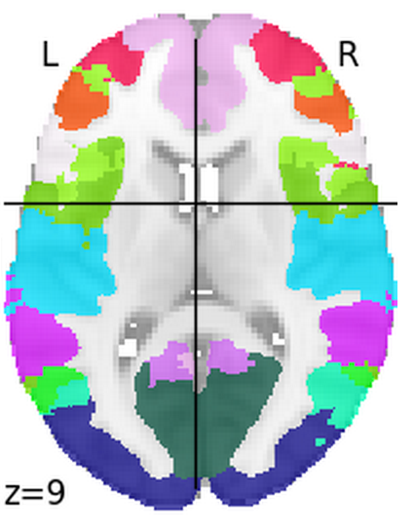
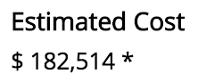
Notes:
Neuroimaging datasets are constantly growing in sample size, resolution, and complexity. There is also an increasing interest in data-driven analysis methods. Nilearn is a scientific computing package in Python that has been designed to address these new challenges in contemporary data analysis in imaging neuroscience. It provides state-of-the-art machine-learning methods for convenient pre-processing, analysis, and visualization of various types of neuroimaging results (i.e., experimental fMRI, VBM, and resting-state correlations).
-> Novice and expert users
- Nilearn can leverage a diverse set of unsupervised and supervised data analysis scenarios by integration with a well-mainted and growing general-purpose machine-learning library (i.e., scikit-learn)
-> high-dimensional problems -> classical software packages (such as SPM) can reach their limits
-> reach a new level of standardization for this stack of analysis methods that typically have many parameter choices
Operating System: Agnostic
unit tested
continuous integration
Given hosting on the coding plattform Github, Nilearn further encourages inter-laboratory collaboration towards software quality and data-analysis standards for the scientific community
entire code base is optimized for parallel and distributed computing as well as large data quantities
software engineering standards
it is an OpenSource software package -> we are looking forward to your contribution
We calculate the estimated cost of the project using the Basic COCOMO model; COCOMO was created to model large institutional projects

